Slide 1


Welcome to Logical Thinking
Spring 2021

Slide 2

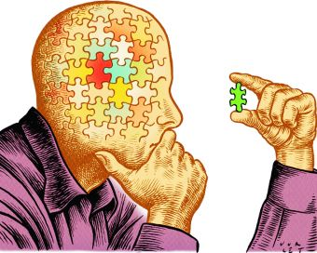
Introduction
Name-A Little About Yourself
What is this course about?

Slide 3
Course Essentials
Office Location: F301– Room 06
Office Hours:
Monday 12:00pm –03:00pm
Wednesday 12:00pm – 03:00 pm
Email: sophia.shahid2@ucp.edu.pk
Announcements
cms.ucp.edu.pk

Slide 4
Breakdown
5 Assignments
8 Quizzes
1 Mid-term
1 Final-term
4 Class activities (graded )

Slide 5
Breakdown
Quiz 15%
Assignment 15%
Midterm 20%
Class Participation 10%
Final term 40%

Slide 6
Marks policy
Marks will not be updated after one week of uploading them on online portal.
Please check your online portal (cms.ucp.edu.pk) everyday for updates.

Slide 7
Assignment / Deliverables submission policy
You are supposed to submit your assignments on cms.ucp.edu.pk. Submission policy is :
On time : No deduction
On day late submission : 20% deduction
After one day submission: Not accepted.

Slide 8
Cheating / plagiarism policy
Cheating is strictly not allowed. Cheating policy will be :
Will be awarded 0 marks in that submission.
Case will be sent to DC committee.

Slide 9
Attendance policy
Attendance will be marked in start of the class. Policy will be :
On time : Present
After attendance + In first 15 minutes : Late
After 15 minutes : Absent.

Slide 10
Reference BOOK:
Mathematical Thinking and Quantitative Reasoning by Richard N. Aufmann

Slide 11
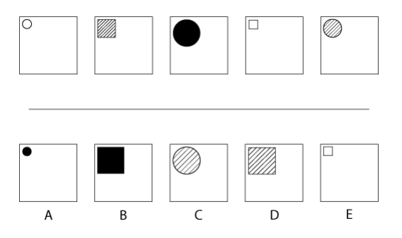
Simple Logic
Notes:
The shapes grow small, medium, then large, then start again.
The shapes alternate between circle and square
The shading in the shapes increases from empty, to hatched, and to full shading.

Slide 12


Keeping it Simple

Slide 13
Identifying Learning How easy (or hard) is it to recognize & justify learning?

Slide 14
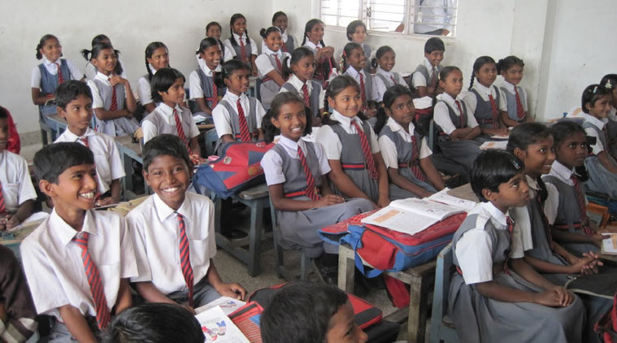

Slide 15
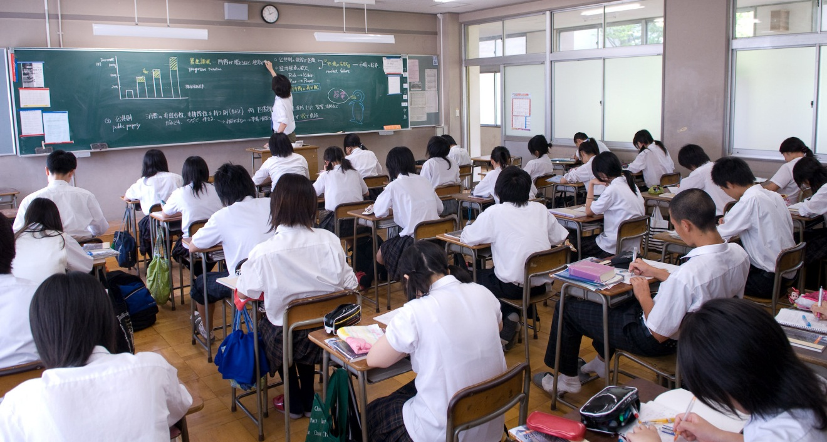

Slide 16
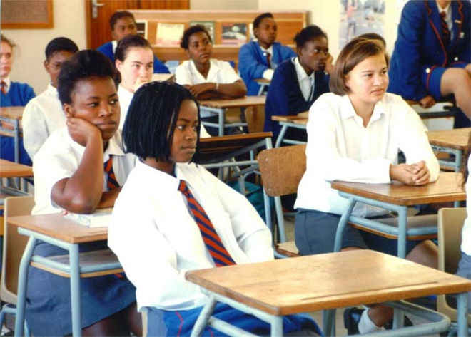

Slide 17
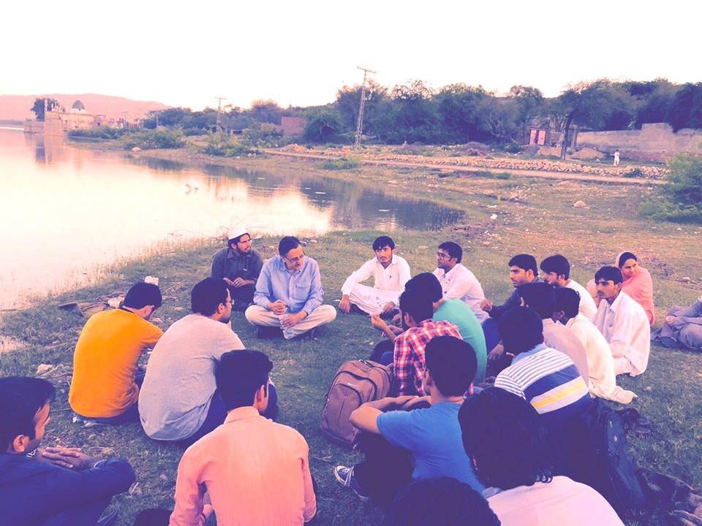

Slide 18
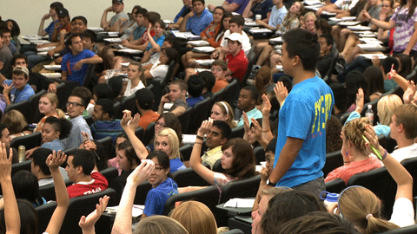

Slide 19


Slide 20
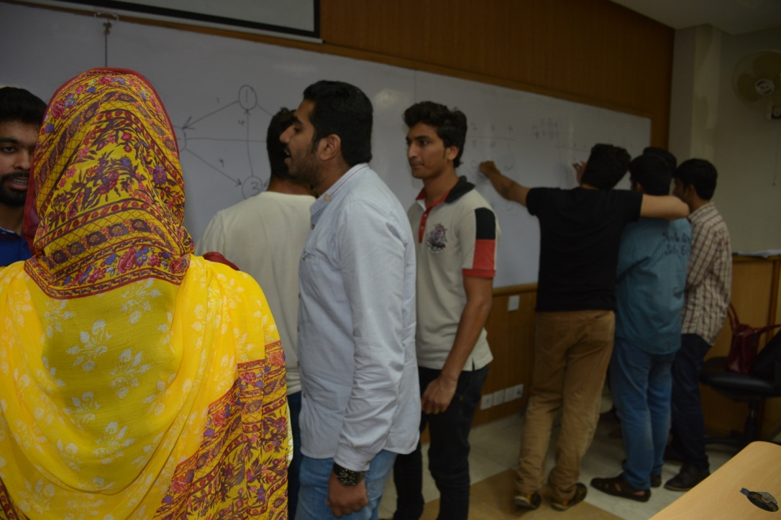

Slide 21

Let’s Group Up!
Form groups of 5 and capture images depicting learning
Take 10 mins.
Discuss!

Slide 22
Class activity
Play minesweeper online.
Try to understand logic behind this game.

